Slide 1

Green Pace
Security Policy Presentation
Developer: Edrian Saguiped

Slide 2

OVERVIEW: DEFENSE IN DEPTH
This security policy was needed because it gave an overview of the variety of securities we can implement here in Green Pace to develop a basis for a secure coding environment.

Slide 3
THREATS MATRIX
The threats matrix table shows us that there are a variety of threat levels and with each given threat, we deal with it using relevant coding standards to mitigate them.
Likely Threats occurring | Priority Standards and policies that have relevance
Low priority Standards and policies that have little to no relevance | Unlikely Threats not occuring

Slide 4
10 PRINCIPLES
S = Coding Standard affiliated with the given security principles
Validate Input Data (S1, S3, S9)
Heed Compiler Warnings (N/A)
Architect and Design for Security Policies (N/A)
Keep It Simple (S8, S10)
Default Deny (N/A)
Adhere to the Principle of Least Privilege (N/A)
Sanitize Data Sent (N/A)
Practice Defense in Depth (S6)
Use Effective Quality Assurance Techniques
Adopt a Secure Coding Standard (S2, S4, S5, S7)

Slide 5
CODING STANDARDS
Do not cast to an out-of-range enumeration value (Medium)
Do not depend on the order of evaluation for side effects (Medium)
Guarantee that storage for strings has sufficient space for character data and the null terminator (High)
Do not access freed memory (High)
Honor replacement dynamic storage management requirements (High)
Use a static assertion to test the value of a constant expression (Low)
Overload allocation and deallocation functions as a pair in the same scope (Low)
A signal handler must be a plain old function (High)
Preserve thread safety and liveness when using condition variables (Low)
Obey the one-definition rule (High)

Slide 6
ENCRYPTION POLICIES
Encryption At Rest - Data that’s not being utilized, examples are moving between devices or networks. This type of data is usually stored on hard-drives, laptops, cloud storage, etc.
Encryption In Transit - Encrypted data is active by movement between devices and networks. Examples of this can include: Moving internally within the organization’s on network or being uploaded to the cloud for backup.
Encryption In Use - This is where the CPU performs actions in regards to the data such as viewing, coding, or playing a file. If it is being built, modified, or viewed it is considered “in use”.

Slide 7
TRIPLE-A POLICIES
Authentication - Authentication is a method where proof of someone’s identity has to be verified to be granted on to the system if they have the proper authorization. There are 5 main authentication factors that we use present time.
Authorization - Authorization is an act of granting someone access to a confidential file, location, network if they have the proper clearance. Based on certain permissions, this can affect what actions they can perform and what they can do with the data.
Accounting - Accounting is having someone taking responsibility of their actions with the clearance they were given along with executing their actions as they were supposed to do.

Slide 8
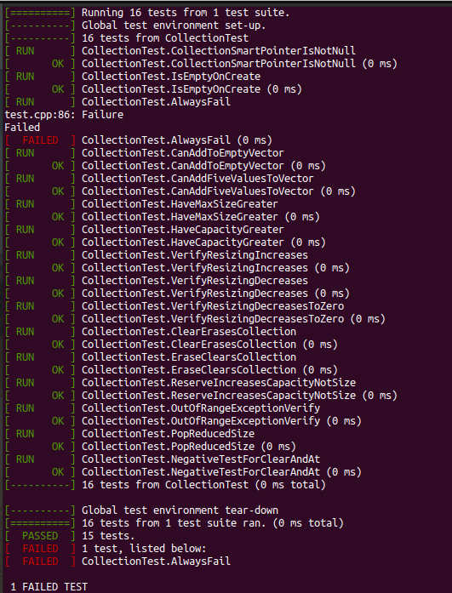
Unit Testing
The coding vulnerability I chose to test was the collection tests. I conducted 16 different tests. 15 passed while 1 failed. This told me which test failed and what I needed to fix.

Slide 9

AUTOMATION SUMMARY

Slide 10
TOOLS
DevSecOps (Development, Security, Operations) pipeline is an approach used to secure the software development lifecycle at every stage to ensure applications are protected throughout the process.
These tools help build a solid foundation when working with the system. Good security practices such as implementing DiD (Defense In Depth) and pre-testing are good ways to know that the system is secure to the organization’s standards.

Slide 11
RISKS AND BENEFITS
Acting as soon as possible is most ideal when facing a threat in an organization. That way the threat can be taken care of in a timely manner before things get worse. It’s important to note too that actions before a threat is taken place is also practical in cyber. This ensures you have a plan to eradicate the threat and know what to do based on proper planning and practice. On the other hand, if we wait to address a threat, we risk losing image, customers, resources, etc. Steps we should take is secure our systems the best we can by any ethical means necessary, have an incident plan ready, and be prepared because an incident can happen anytime.

Slide 12
RECOMMENDATIONS
Strong passwords that meet complexity requirements so attacks such as brute force, dictionary, password spraying are ineffective.
Secure Wi-fi so attackers have a harder time accessing personal files and data.
Backups are important to to make sure data can be accessed at all times.

Slide 13
CONCLUSIONS
Standards that should be adopted to prevent future problems would include:
Identifying risks present to make sure the policy is updated to take care of that risk.
User training is important as well because we can have all of these technical and administrative controls in place but if a user is ignorant and unaware of his actions and surroundings, it makes it that much easier for malicious activity to find its way into an organization.
Installation of proper tools such as Anti-Viruses are important as well too so we are better equipped in setting up our security and defenses.

Slide 14
REFERENCES
Datalocker. (2021, September 1). Encryption: Understanding data at rest vs. in transit. DataLocker Inc. Retrieved from https://datalocker.com/blog/technology/encryption/encryption-at-rest-vs-in-transit-effectively-encrypt-identifiable-information/
S., J. (2020, June 7). What is AAA in cyber security? (must know info). Cyber Security Kings. Retrieved from https://cybersecuritykings.com/2020/06/07/what-is-aaa-in-cyber-security-must-know-info/#:~:text=AAA%20stands%20for%20Authentication%2C%20Authorization,access%2C%20by%20logging%20their%20activities.
VMware. (2022, July). What is DevSecOps?: DevSecOps vs. DevOps. VMware. Retrieved from https://www.vmware.com/topics/glossary/content/devsecops.html
Seacord, R. (2018, May 2). Top 10 secure coding practices. Top 10 Secure Coding Practices - CERT Secure Coding - Confluence. Retrieved November 10, 2022, from https://wiki.sei.cmu.edu/confluence/display/seccode/Top+10+Secure+Coding+Practices
Snavely, W., & Ballman, A. (2018, March 22). 2 rules. 2 Rules - SEI CERT C++ Coding Standard - Confluence. Retrieved from https://wiki.sei.cmu.edu/confluence/display/cplusplus/2+Rules

